Slide 1


Drug/Device Product Development and Regulation – Europe and US “From the lab bench to the bedside – a fantastic voyage of drug/device development”
Swiss Federal Institute of Technology, Lausanne (EPFL)
Module on Drug Development
August 22 to September 30, 2022

Slide 2
Drug/Device Product Development and Regulation - Europe and US
PART ONE: TEN STEP OVERVIEW.
PART TWO: COMPLIANCE AND REGULATIONS.
COMPARISON EMA AND FDA.

Slide 3
Drug/Device Product Development and Regulation - Europe and US Drug Development Process: Ten Step Overview.
PART ONE: TEN STEP OVERVIEW.

Slide 4
RA 761: Drug/Device Product Development and Regulation - Europe and US Drug Development Process: Ten Step Overview.
Making a Medicine: The basic principles of medicine discovery and development

Slide 5
Overview
It takes over 12 years and costs on average over €1 billion to do all the research and development necessary before a new medicine is available for patients to use.
Medicines development is a high risk venture.
Around 98% of medicines that enter development being developed do not make it to the market
This is largely because the benefits and risks of development do not compare well with medicines that are already available.

Slide 6
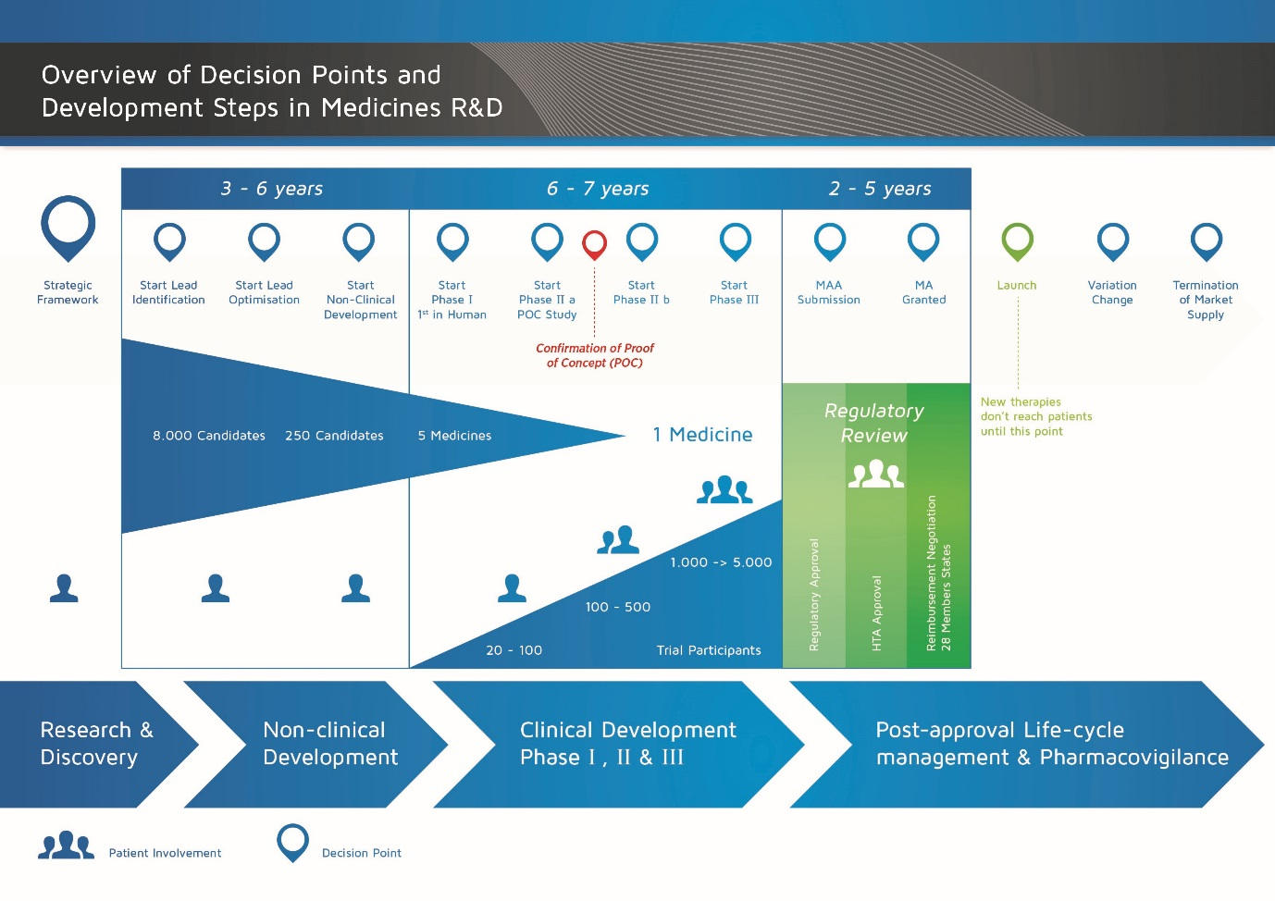
The medicines development process
Notes:
The steps involved in developing a new medicine are described below.

Slide 7
STEP 1: Discovery (1)
Pre-discovery and determining if there is an ‘unmet need’.
Scientists in academia (universities) and in the industry (pharmaceutical companies) work to understand the disease in the pre-discovery phase.
An ‘unmet need’ refers to a disease where either:
there is no suitable medicine available, or
there is a medicine available, but some patients may be unable to take it due to unacceptable side effects that they experience.
Notes:
Pre-discovery and determining if there is an ‘unmet need’
Scientists in academia (universities) and in the industry (pharmaceutical companies) work to understand the disease in the pre-discovery phase.
An unmet need refers to a disease where either:
there is no suitable medicine available or
there is a medicine but some patients might have unacceptable side effects and are not able to take it.

Slide 8
STEP 1: Discovery (2)
The research and development process requires a lot of resources and is very expensive.
There are many unmet needs where new medicines are not currently being developed.
The regulatory submission and approval process must be passed before the medicine can be marketed.
Notes:
The research and development process uses lots of resource and is expensive. Companies may only start a new programme for an unmet need if there is a commercial case to do so. This is because companies need to profit from the new medicine in order to pay their development costs and invest in projects for new medicines. There are many unmet needs where new medicines are not currently being developed. The European legislators are aware of this and they offer incentives and rewards to support the development of medicines in more difficult cases e.g. for patients with rare diseases or children.
The basic steps in medicines development are shown in the diagram and explained further in the sections below. One important step is the regulatory submission and approval process which has to be passed before the medicine can be marketed (launched). However, this is not in the hands of the company.
Each phase involves getting agreement for the money (investment) and the people to do the work – called an ‘investment decision’ (ID). The results are then reviewed before the next activity can start.
This pattern of “investment decision – activity – results – investment decision” continues for the entire development process. This means that if the results are not satisfactory, the project will be stopped and the financial and human resources can then be directed to other projects.

Slide 9
STEP 1: Discovery (3)
Every phase of development requires an agreement for the money (investment) and the people (resources) to do the work. This agreement is called an ‘Investment Decision’ (ID).
After the ID has been obtained, activities for the next research phase can begin. This pattern of ‘ID – activity – results – ID’ continues for the entire development process.
Notes:
The research and development process uses lots of resource and is expensive. Companies may only start a new programme for an unmet need if there is a commercial case to do so. This is because companies need to profit from the new medicine in order to pay their development costs and invest in projects for new medicines. There are many unmet needs where new medicines are not currently being developed. The European legislators are aware of this and they offer incentives and rewards to support the development of medicines in more difficult cases e.g. for patients with rare diseases or children.
The basic steps in medicines development are shown in the diagram and explained further in the sections below. One important step is the regulatory submission and approval process which has to be passed before the medicine can be marketed (launched). However, this is not in the hands of the company.
Each phase involves getting agreement for the money (investment) and the people to do the work – called an ‘investment decision’ (ID). The results are then reviewed before the next activity can start.
This pattern of “investment decision – activity – results – investment decision” continues for the entire development process. This means that if the results are not satisfactory, the project will be stopped and the financial and human resources can then be directed to other projects.

Slide 10
STEP 2: Target Selection (1)
Diseases occur when the normal body processes are altered or not functioning properly.
When developing a medicine, it is important to understand in detail (at the level of the cells) what has gone wrong. This allows the abnormal process to be ‘targeted’.
The ‘target’ may be:
A molecule that has been produced in excess interfering with normal body function,
A molecule not being produced in normal amounts, or
A molecule that has an abnormal structure.
Notes:
Target Selection
Diseases occur when the normal body processes are altered or not functioning properly. When developing a medicine, it is important to understand in detail (at the level of the cells), what has gone wrong. This means that the abnormal process can then be ‘targeted’ and corrected. The ‘target’ may be a molecule that has been produced in excess interfering with normal body function, or not being produced in normal amounts, or one that has an abnormal structure. For example, in cancer there can be too much of a chemical messenger signalling the cells to grow abnormally, and in diabetes, there is a lack of insulin production or the cells don’t respond to it.

Slide 11
STEP 2: Target Selection (2)
The nucleus contains the genetic material and acts as the control centre for the cell.
Receptors allow chemical messengers (in this case, the Growth Factor) to communicate with the cell nucleus, stimulating cell activity.
Notes:
Figure 2 shows a simple representation of a cell, with a nucleus and a receptor on the cell surface.
The nucleus acts as the control centre for the cell – it contains the genetic material.
The receptor allows chemical messengers to communicate with the cell.
In many cases it is impossible to know in detail what has gone wrong. Often in a disease, there are several abnormalities or ‘targets’, but scientists cannot tell precisely which target is responsible for the disease, or these abnormalities have not caused the illness and therefore trying to correct them will not treat the disease. In this case, the development project might be pursuing the wrong target, and ultimately it will fail. Therefore selecting the best target to work on in a project is crucial.

Slide 12
STEP 2: Target Selection (3)
Example: Cancer
A chemical messenger combines with the growth factor receptor on the cell surface, a message is generated inside the cell.
If the signalling is uncontrolled, the cellular growth leads to cancer.
Blocking the receptor in cancer cells will prevent transmission of the message and will prevent uncontrolled cell growth.
If you can block the receptor in cancer cells, this will:
stop the message being sent, and
prevent uncontrolled cell growth
Notes:
When a chemical messenger, in this case the ‘growth factor’, combines with the growth factor receptor on the cell surface, a message is generated inside the cell. This then communicates with the nucleus and the cell is then stimulated to divide. When the signalling is uncontrolled, the cellular growth leads to cancer. Blocking the receptor in cancer cells will prevent transmission of the message and will prevent uncontrolled cell growth. If you can block the receptor in cancer cells, this will:
stop the message being sent and
prevent uncontrolled cell growth.
The ‘target’, in this example, is therefore the growth factor receptor.

Slide 13
STEP 2: Target Selection (4)
Scientists often cannot tell precisely which abnormality or target is responsible for the disease; therefore, attempts to correct targets may not treat the disease.
If this is the case, the development project might be pursuing the wrong target, and ultimately it will fail.
Selecting the best target to work on in a project is crucial for success.

Slide 14
STEP 3: Lead Generation
This step involves finding a molecule that will interact with the target. These are called ‘leads’.
Leads can be molecules that are naturally occurring or chemically manufactured.
Leads can also be large molecules or proteins. These are called ‘biologics’.
Testing for leads is called a ‘screening process’.
Robotic technology called ‘High throughput screening’ allows millions of molecules to be tested quickly.
Once the leads have been generated or found, the process can move to the next step.
Notes:
Lead Generation
This step consists in finding a molecule that will interact with the target. The molecule might come from a natural source, e.g., a plant, or might have been made by chemists. These are called ‘small molecules’. Hundreds of thousands of molecules will be tested to find ‘leads’ – ones that interact with the target. Testing for leads is called a screening process. Modern robotic technology allows for ‘high throughput’ screening. This means that millions of molecules can be tested quickly. Once the leads have been generated or found, the process can move to the next step.
It is also possible to find large molecules (proteins) which interact with the target. These large molecules are much more complicated to make. They are produced by biotechnology processes and are therefore described as ‘biologics’. In biotechnology, the large molecules are produced by host cells of a living organism, such as bacteria, yeasts, or animal cells in large fermentation vats. The proteins are then separated and purified. The purified proteins can then be used to explore interactions with the target.
Traditionally the pharmaceutical industry produced ‘small molecules’ which were then developed as new medicines. Currently large molecules (proteins) or ‘biologics’ are produced. Both small molecules and biologics are important in medicines development.

Slide 15
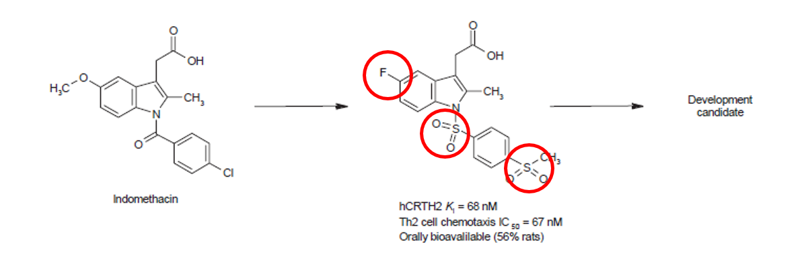
STEP 4: Lead Optimisation (1)
A selected lead may have only a weak effect on the target. Chemists must then alter the selected lead molecule in order to increase its effect on the target.
Elements are added or removed from the original lead in order to increase its effect, resulting in a range of slightly different molecules.
Optimisation of indomethacin to a potent CRTH2 antagonist.
Notes:
Lead Optimisation
Modifications of the molecule to improve its effect. The screening process identifies ‘leads’ - molecules which interact with the target. However, these molecules often have only a weak effect and would not be suitable for further development.
Chemists alter the selected ‘lead’ molecule by adding or deleting elements. This creates a range of slightly different molecules.
The molecule of an existing medicine could also be modified to improve or change its effect.
Computer technology can help to design these molecules.
These modified molecules will be tested to determine which structure has the best efficacy and is better tolerated (safety).). These studies help to gain understanding of the pharmacology of the molecule, meaning the way the molecule works in the body. The molecules with better efficacy and safety can then proceed for further testing as a ‘candidate drug’ Around this stage the scientific and technical information about the candidate compound, such as its molecular structure and effects, is usually registered, or patented, to protect its intellectual property

Slide 16
STEP 4: Lead Optimisation (2)
These modified molecules are then tested to determine which structure has the best efficacy and is better tolerated by the body (safety).
The molecules with better efficacy and safety can then proceed for further testing as a ‘candidate medicine’.
At around this stage, the scientific and technical information about the candidate compound, such as its molecular structure and effects, is usually registered, or patented, to protect it as intellectual property.

Slide 17
STEP 5: Non-clinical Safety Testing (1)
The next stage in the development process involves safety testing in animals, which is governed by specific rules and regulations of Good Laboratory Practice (GLP).
These regulations state which studies must be done and which type of animals must be used to obtain reasonable information.
Notes:
Non-clinical Safety Testing
Is it safe to proceed to clinical testing? The next stage in the development process involves safety testing in animals, which is governed by specific rules and regulations of Good Laboratory Practice (GLP). No candidate medicine can be tested in humans (in "clinical studies") before its safety profile has been established in animal safety studies. Medicines development is tightly controlled. The law imposes rules and regulations about what is done, and how it is done.
Before the non-clinical testing work can be done, larger amounts of the candidate compound need to be produced so that all the appropriate tests can be carried out. This manufacturing process also has to follow strict guidelines and regulations called Good Manufacturing Practice (GMP).

Slide 18
STEP 5: Non-clinical Safety Testing (2)
The GLP and Non-clinical regulations require information to be gathered about the effects of the medicine:
In the animal overall
In all the animal’s tissues and organs (systemic toxicology studies)
On the ability of the animals to reproduce and develop normally (reproductive toxicology studies)
On the skin or eyes (local toxicology studies)
On the chromosomes and genes (genotoxicity studies)
Any effects on cancer generation (carcinogenicity studies)

Slide 19
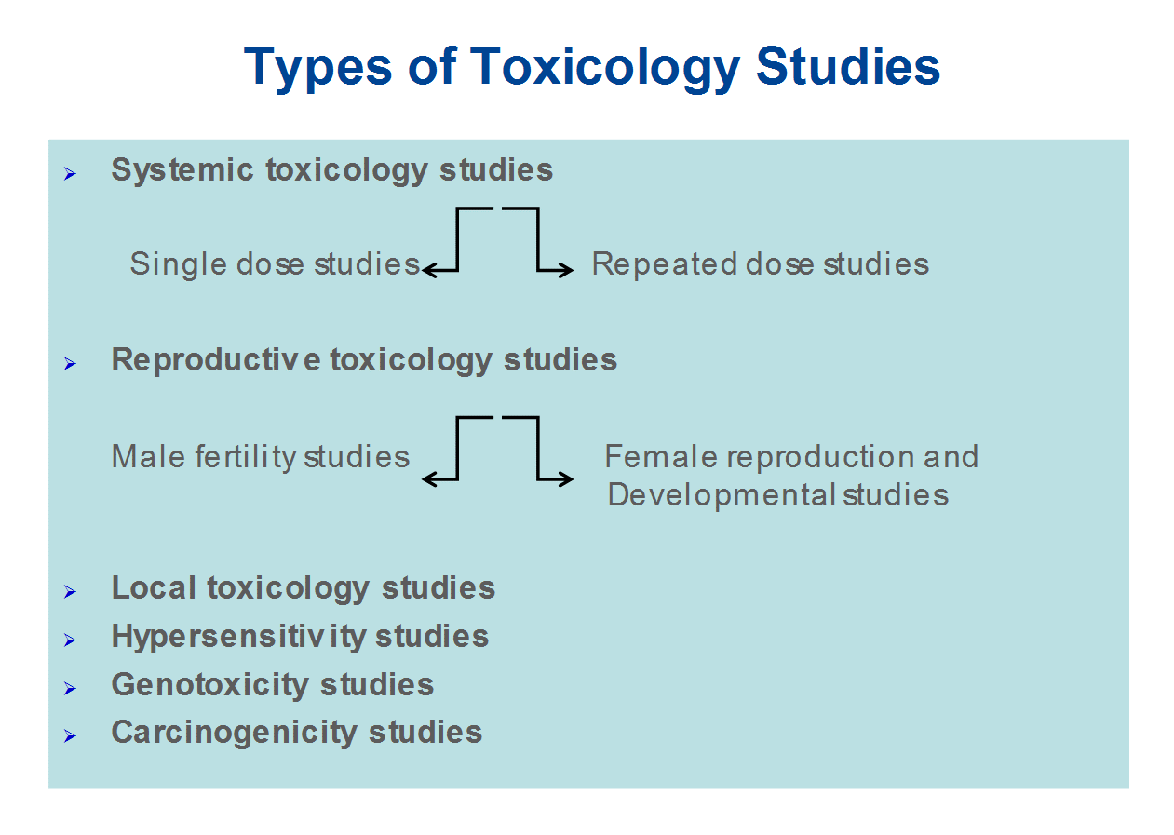
STEP 5: Non-clinical Safety Testing (3)

Slide 20
STEP 5: Non-clinical Safety Testing (4)
These studies not only show the safety profile in animals, but also provide important information about:
how the substance enters the body (Absorption)
distribution around the body (Distribution)
breakdown of the substance by the body (Metabolism)
how the substance leaves the body (Excretion).
This is sometimes abbreviated to ‘ADME’.
All of this information is used to decide if the candidate compound can proceed into the first human (clinical) study and if so, what doses to use.
Notes:
These studies not only show the safety profile in animals, but also provide important information about:
how the substance enters the body (Absorption)
Distribution around the body
breakdown of the substance by the body (Metabolism)
how the substance leaves the body (Excretion).
This is sometimes abbreviated to ‘ADME’.
All of this information is used to decide if the candidate compound can proceed into the first human (clinical) study and if so, what doses to use.
Summary: To continue into clinical testing, with humans, the candidate compound must have shown an acceptable safety profile in all the necessary non-clinical toxicology studies. However, not all of the non-clinical safety studies will have been completed. For example, long-term carcinogenicity studies take on average two years and continue at the same time as the clinical trials.

Slide 21
STEP 6: Proof of Mechanism – Phase I Clinical Studies (1)
Before starting a clinical study, a Clinical Trial Application (CTA) must be submitted to the National Competent Authority (NCA) for approval.
An opinion from the ethics committee is also sought.
Safety is the top priority; a study in humans cannot start until approval is received from:
the Internal Company Review Committee,
the External Ethics Committee, and
the External Regulatory Authority have given their approval.
Notes:
Proof of Mechanism – Phase I Clinical Studies
The decision to start the first clinical study is a major one. As a candidate compound continues through the development process, the number, the cost and the complexity of the activities all increase.
Before starting a clinical study, a Clinical Trial Application (CTA) has to be submitted. The CTA must include the following important documents:
An Investigational Medicinal Product Dossier (IMPD), including ADME and studies to observe effect (on the target), the toxicology safety, and information on how the medicine is manufactured
The Study Protocol describing the details of performing the study and evaluating the results
The Investigator’s Brochure (IB), providing a summary of the information that allows the doctors who run the study (the investigators) to understand how the study drug works in the body (the pharmacology). This allows the investigators to explain the study to the volunteer or patient and to obtain informed consent (see below).
The CTA must be submitted to the National Competent Authority (NCA) for approval. During the process an opinion from the Ethics committee is also sought.
Safety is the top priority, hence, a study in humans cannot start until the Internal Company Review Committee, the External Ethics Committee and the External Regulatory Authority have given their approval.

Slide 22
STEP 6: Proof of Mechanism – Phase I Clinical Studies (2)
Volunteer studies (or Phase I clinical studies) allow doctors and scientists to test if the medicine is safe in humans. These are called ‘proof of mechanism’ studies.
Phase I clinical studies look at whether the medicine behaves in humans in the same way that it behaved in animals.
All the information coming from the study is collected in a document called the Case Record Form (CRF).
Two very important elements are:
Informed consent (ensuring that the participants understand what is going to be done and agree to be part of the study), and
Ethics Committee review and opinion
Notes:
Volunteer Study (also called Exploratory Study, Proof of Mechanism study or Phase I Study)
This study allows the doctors and scientists to see if the medicine is safe in humans. It also looks at whether the medicine behaves in humans in the same way that it behaved in animals. These studies provide information on the way that the medicine works – called the ‘mechanism of action’. These studies also aim to find secondary effects of the medicine.
About 20 -100 volunteers are included in the Phase 1 of the clinical studies. These studies are usually carried out in special Phase 1 units where the volunteers are recruited and the studies are run. The doctors who carry out these studies are called investigators and they are qualified to conduct clinical trials in order to determine the outcome of the study.
The first clinical study is usually carried out in healthy, male volunteers. The details of the clinical study have to be described in the Study Protocol, this has to include:
the background of the disease (the unmet need).
the non-clinical information.
the details of the clinical study (what exactly will be done and when).
how the information will be used and analysed.
All the information coming from the study is collected in a document called the Case Record Form (CRF).
Here, too, there are a large number of guidelines and regulations known as Good Clinical Practice (GCP) to protect the safety of the participants in the study.
The Study Protocol also has a section on ‘statistics’ which are the statistical tests used to analyse the results. These directions have to be decided before the study starts, so it is known how the information will be obtained and used once the study ends.
Two very important elements are:
informed consent (ensuring that the participants understand what is going to be done and agree to be part of the study) and
Ethics Committee review and opinion
The Ethics Committee is an independent group, usually consisting of doctors, scientists, nurses, and non-experts (‘lay’ members). They review the Study Protocol (especially the informed consent form) and ensure that they comply with the ethical regulations of the committee before the study is carried out. Safety has the highest priority and to ensure the safety of the participants in a clinical study, internal company approval, external Ethics Committee positive opinion, and NCA approval is required. The rules for Phase I studies became even stricter after a rare case in 2006 in which volunteers suffered serious side effects after using an immunomodulatory medicine to treat B cell chronic lymphocytic leukemia and rheumatoid arthritis.

Slide 23
STEP 6: Proof of Mechanism – Phase I Clinical Studies (3)
As safety is a priority, the first clinical study starts with a single, very low dose of the medicine. This dose is then increased.
These studies are known as Single Ascending Dose (SAD) studies. They are usually followed by a Multiple Ascending dose study, where each volunteer is given multiple doses.
The study results are then analysed and all the safety measurements assessed, including:
Pharmacokinetics: what the body does to the medicine. The levels of the medicine in the blood can be measured to determine the ADME.
Pharmacodynamics – what the medicine does to the body (the ‘effect’).
Notes:
As safety is a priority, the first clinical study starts with a very low dose of the medicine:
A single dose of the medicine is used for each volunteer.
Once it has been shown that there are no safety concerns with this first dose, the study can continue with a slightly higher dose.
The dose will then be further increased (‘ascending dose’) until the maximum dose allowed for the study has been reached.
This is described in the Study Protocol.
The study results can then be analysed and all the safety measurements can be assessed. This includes the:
pharmacokinetics – what the body does to the medicine. The blood levels of the medicine can be measured – to determine the Absorption, Distribution, Metabolism and Excretion (ADME – see also non-clinical studies above).
pharmacodynamics – what the medicine does to the body (the ‘effect’). For example, the study might measure the effect of a medicine on certain blood cells.
This type of study is known as a Single Ascending Dose (SAD) study. This is usually followed by a Multiple Ascending Dose (MAD) study which, as the name suggests, involves multiple doses per volunteer.
Apart from the SAD and MAD studies, other Phase I studies are also needed. For example:
to look at the effect of food
to look at the effect of other medicines given at the same time
to look at the effect of other diseases which might mean a different dose of the medicine is needed (e.g., in patients with kidney disease).

Slide 24
STEP 7: Proof of Principle - Phase II Clinical Studies (1)
If the Phase I study results show that it is safe to proceed, the next step is to start clinical trials in patients with the disease that is being treated.
There are usually two treatment groups:
one group that receives the active medicine,
one group that receives a medicine that has no effect on the body (a ‘placebo’).
These trials are usually carried out in 100 – 500 patients. They are designed to gather information about the effect of the medicine on the actual disease (‘proof of principle’).
Notes:
Proof of Principle - Phase II Clinical Studies
Trials in patients. Once the volunteer study results have shown that it is safe to proceed, the next step is to start clinical trials in patients with the disease that is being treated. The same guidelines and regulations apply.
In Phase II and Phase III studies, there are usually two treatment groups. One group has the active medicine and one group has a dummy medicine which has no effect on the body (called a ‘placebo’). These studies are normally run as ‘double-blind’, ‘randomised’, ‘placebo-controlled’ studies. This is known as the ‘gold standard’ – the best way to design a clinical study to get a clear answer.
‘Double-blind’ means that both the doctor and the participant do not know who is receiving the active medicine or placebo.
‘Randomised’ means that the treatment groups are chosen by chance. This is usually done with a computer that generates a random code. It cannot be influenced by the doctor or anyone else.
‘Placebo-controlled’ means that some participants will receive a placebo given under the exact same conditions as the active medicine. This allows the effects related to the medicine to be separated. For example, if a participant in a study complains of a headache it is important to know if that is related to the active medicine. If the same number of participants receiving placebo complain of headaches, this shows that the headache cannot be due only to the active medicine.
All the details of the trial are described in the Study Protocol and the information is collected in the Case Record Form. The results will be analysed using statistical tests.
These trials are usually carried out in 100 to 500 patients. They are designed to get information about the effect of the medicine on the actual disease (‘proof of principle’). This is also the stage when different doses of the medicine are used to find out which is the best dose. This dose is then used for the next phase of larger clinical studies.
The more that can be learned about the effect in the patients at this stage, the easier it is to decide if the development should continue. However, Phase II studies are too small to be able to provide sufficient evidence about efficacy and safety. Therefore, building up more and more information about how the medicine works in patients reduces the risk of failing at the next stage (Phase III or Development for Launch), which is the most complicated and expensive phase of development

Slide 25
STEP 7: Proof of Principle - Phase II Clinical Studies (2)
The studies are usually run in several hospital sites by hospital doctors called investigators. Conducting trials in several different sites at the same time is more complicated than conducting a trial in a single site.
By the end of the Phase II studies, the programme will have:
taken 8.5 years, on average.
cost €1 billion, on average.
Of 10 medicines that are tested in Phase I and Phase II, only 2 on average will continue to the next phase.
Notes:
Because these Phase II studies are carried out in patients, the studies are usually run in several hospital sites by hospital doctors called investigators, opposite to the Phase I performed in special units.
Conducting trials in several different sites at the same time is more complicated than conducting a trial in a single site:
All the investigators and study nurses have to be trained using an established protocol that is conducted the same way in all the sites.
The medicine has to be exported to different countries and stored properly in the different pharmacies.
The blood samples collected from patients in the clinical trial are usually sent to a single central laboratory.
All the local country rules and regulations have to be understood and followed.
Ethics Committee opinion and NCA approval is usually required in each country.
All of this has to be coordinated by the global study team.
Summary: By the end of the Phase II studies, the programme will have:
taken 8.5 years, on average
cost €1 billion, on average.
Of 10 medicines that were tested in Phase I and Phase II, on average only 2 will continue to the next phase.

Slide 26
STEP 8: Confirmatory Studies – Phase III Clinical Studies (1)
Phase III trials (confirmatory studies) aim to confirm the efficacy and safety of a medicine in a large patient population.
All of the information gathered from the earlier stages is used to make important decisions, including the final formulation of the medicine and the dose that is to be tested.
Phase III studies can involve thousands of patients, are run in many countries, require a huge amount of expertise to be run effectively, and are therefore very expensive and time consuming.
Notes:
Development for Launch - Phase III Clinical Studies (also called Confirmatory Studies)
Phase III trials (confirmatory studies) are the largest, most complicated and most expensive part of the development of a medicine. They aim to confirm the efficacy and safety in a large patient population.
The decision to go on to Phase III trials is only made if it is supported by all the information from earlier studies, manufacturing, and business units. The design of such trials is also critically important. Therefore, there is a large amount of discussion with the external experts, Regulatory Authorities, patient groups and others. This ensures that the right questions are being asked and the right information is being collected. The number of patients in the trial is also very important so that the results can be properly interpreted and will meet the requirements of the Regulatory Authorities.
All of the information gathered from the earlier stages is used to make important decisions including:
the final formulation of the medicine (how the active medicine is combined with other chemical substances)
the dose to be tested
which patients can be recruited (inclusion criteria)
which patients cannot be included (exclusion criteria)
how many patients are required
the study design
length of the study
how efficacy and safety will be measured
the statistical tests that will be used
At this stage the trials may involve thousands of patients. However, this depends on what the medicine is planned to treat (the ‘indication’).
Phase III studies can involve thousands of patients, are run in many countries, require a huge amount of expertise to run them effectively, and are therefore very expensive and time consuming. However, this is the only way to produce a clear answer between the efficacy of the medicine (it works) and its safety (it is well tolerated), which is an important.

Slide 27
STEP 8: Confirmatory Studies – Phase III Clinical Studies (1)
However, this is the only way to produce a clear answer between the efficacy of the medicine (how well it works) and its safety (if it is well tolerated).
Over 50% of the medicines that reach Phase III fail. The overall failure rate for projects beginning at the discovery stage is more than 97%.
The revenue from the few medicines that make it to the market will cover the cost of all the projects, the failures as well as the successes.
Notes:
Summary: Phase III studies make up the largest, most complicated and most expensive part of the medicine development process. Over 50% of the medicines fail in this step. The overall failure rate for the projects from the discovery stage is more than 97%. The revenue from the few medicines that make it to the market, will cover the cost of all the projects, the failures as well as the successes.

Slide 28
STEP 9: Regulatory Submission (1)
If the results of the Phase III clinical studies show an acceptable risk-benefit relationship, a Marketing Authorisation Application (MAA) can be prepared.
All the information on the medicine (non-clinical, clinical, and manufacturing) is collected and organised in a pre-determined format called a ‘dossier’. The dossier is sent to the Regulatory Authorities (RA).
Once the RA is satisfied with the results (risk-benefit relationship), they will give their approval for the new medicine to be marketed.
Notes:
Regulatory Submission - (Marketing Authorisation Application)
If the results of the Phase III clinical studies show an acceptable benefit-risk relationship, a Marketing Authorisation Application can be prepared. All the information (non-clinical, clinical, and manufacturing) is collected and organised in a pre-determined format. This is called a ‘dossier’ and it is sent to the Regulatory Authorities. The expertise of the staff in the regulatory departments is very important as the different Regulatory Authorities around the world have slightly different requirements.
The International Committee on Harmonisation (ICH) allowed many of the requirements for the USA, Europe and Japan to be harmonised. This has reduced duplication of testing and has simplified the process resulting in a Common Technical Document (CTD) for review.
Once the dossier is received, the Regulatory Authority will review the information, and submit questions to be answered by the staff in the regulatory department who sent the document. Once the Regulatory Authority is satisfied with the results (risk-benefit) they will give their approval for the new medicine to be marketed.

Slide 29
STEP 9: Regulatory Submission (2)
The review process usually takes 12 to 18 months. The medicine will not be allowed to enter the market until the Regulatory Authorities are satisfied and give their approval.
Many countries require studies about the cost effectiveness of the new medicine. These documents will support the government or insurance companies through Health Technology Assessment (HTA) groups to decide and give recommendations about allowing the medicine to be prescribed and paid by the insurance system in the country.
Notes:
The review process usually takes 12-18 months. This period can be shorter in special cases agreed by the Regulatory Authorities, but can be prolonged if there are many questions to answer. The authorities may require more clinical studies before they are prepared to give their approval, and the medicine will not be allowed to enter the market until the Regulatory Authorities are satisfied. Sometimes there are conditions that can’t be accepted by the Regulatory Authorities, and the medicine will not be accepted to go into the market.
In many countries, studies about the cost effectiveness of the new medicine are also required. These documents will support the government or insurance companies through Health Technology Assessment (HTA) groups to decide and give recommendations about allowing the medicine to be prescribed and paid by the insurance system in the country.
One well known Health Technology Assessment body is the National Institute for Clinical Excellence (NICE) in the UK. NICE recommends whether or not the government should allow the medicine to be prescribed.

Slide 30
STEP 10: Marketing and Post-Marketing Safety Surveillance
The marketing process involves sharing information about the new medicine with doctors and other health care professionals so that they are aware of the effects of the new medicine and may prescribe it in cases where they believe patients can benefit.
However, there is still a need to collect and analyse the information about the safety of the medicine when it is used in ‘real‑life’. This process is called pharmacovigilance.
Both clinical trials and real-life data collected post-marketing are necessary to fully understand the real risk-benefit relationship.
Notes:
Marketing and post-marketing safety surveillance
The marketing process involves sharing the information about the new medicine with doctors and other health care professionals so that they become aware of the effects of the new medicine, and may prescribe it in cases where they believe patients can benefit
However, the development process does not stop there. There is still a need to collect and analyse the information about the safety of the medicine when it is used in ‘real‑life’ (called pharmacovigilance). This is because:
In clinical trials (which are designed to give clear answers), patients ideally only have the illness being studied and are not taking any other medicines.
In real-life, a large number of patients take the new medicine. They may have several other illnesses and take a variety of other medicines.
Both the clinical trials and real-life data are necessary to fully understand the real benefit-risk relationship.

Slide 31
STEP 10: Life-Cycle Management
Finally, the development process continues to explore:
Other possible uses (indications) for the medicine. For example, if the initial use was for patients with asthma, a new indication might be for patients with a different type of lung disease.
Improved ways of making and using the medicine (new formulations). For example, a special formulation for children.
All of these activities are known as ‘life-cycle management’.
Notes:
Life-cycle management
Finally, the development process continues to explore:
other possible uses (indications) for the medicine. For example, if the initial use was for patients with asthma, a new indication might be for patients with a different type of lung disease, e.g. chronic obstructive pulmonary disease.
improved ways of making and using the medicine (new formulations). For example, a special formulation for children.
All of these activities are known as ‘life-cycle management’.

Slide 32
STEP 10: Other changes in the life-cycle of a medicine
When a medicine is first marketed, it is protected by a patent. This means that other companies cannot market a similar medicine. At the end of the patent or data protection period other companies will manufacture and market the same product. When this happens, the product is called a ‘generic’.
New medicines are usually licensed as Prescription-Only Medicines (POM). This means that healthcare professionals can supervise their use in the first few years. The medicine can later be made available as an Over-The-Counter (OTC) medicine. This involves a change in the regulatory status of the medicine.
Notes:
Other changes in the life-cycle of a medicine
When a medicine is first marketed, it is protected by a ‘patent’. This means that other companies cannot market a similar medicine. At the end of the patent or data protection period other companies will manufacture and market the same product. When this happens, the product is called a ‘generic’.
New medicines are usually licensed as Prescription-Only Medicines (POM). This means that healthcare professionals can supervise their use in the first few years. Where it is appropriate and safe to do so, the medicine can then be made available as an Over-The-Counter (OTC) medicine. This involves a change in the Regulatory status of the medicine and a new licence is required. Patients can buy the OTC medicine directly from a pharmacy or supermarket.

Slide 33
Drug/Device Product Development and Regulation - Europe and US Drug Development Process – Compliance with Regulations
PART TWO: COMPLIANCE AND REGULATIONS

Slide 34
Drug/Device Product Development and Regulation - Europe and US Drug Development Process
Introduction.
Definitions.
Preclinical overview.
Chemistry, Manufacturing, and Controls (CMC).
Clinical overview.
Regulations - Europe.

Slide 35
Drug/Device Product Development and Regulation - Europe and US Drug Development Process
Introduction.

Slide 36
Drug/Device Product Development and Regulation - Europe and US Introduction
Drug development is the process of bringing a new drug molecule into clinical practice.
In its broadest definition this encompasses all steps from the basic research process of finding a suitable molecular target to supporting the commercial launch of the drug.
In a narrower sense, development refers only to the clinical parts of this process, with discovery used to describe the nonclinical research components.

Slide 37
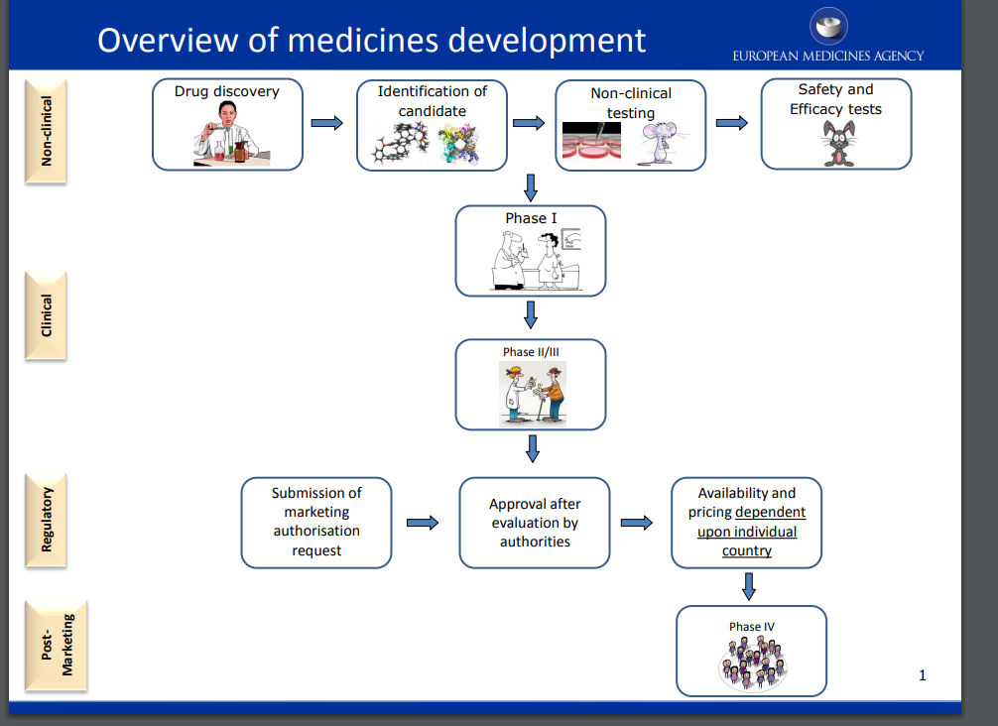
Drug/Device Product Development and Regulation - Europe and US Introduction

Slide 38
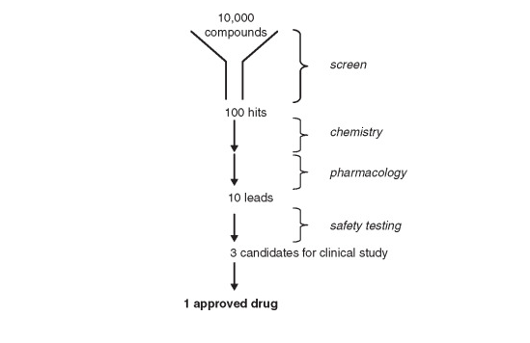
Drug/Device Product Development and Regulation - Europe and US Introduction

Slide 39
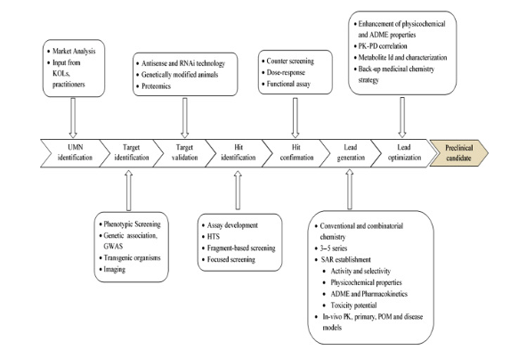
Drug/Device Product Development and Regulation - Europe and US Introduction

Slide 40
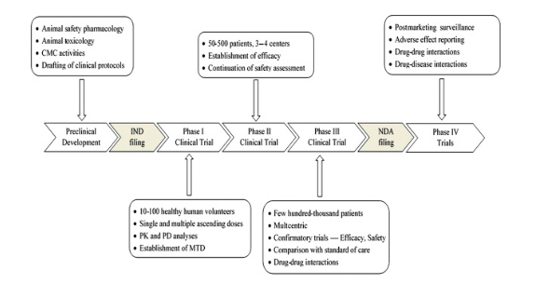
Drug/Device Product Development and Regulation - Europe and US Introduction

Slide 41
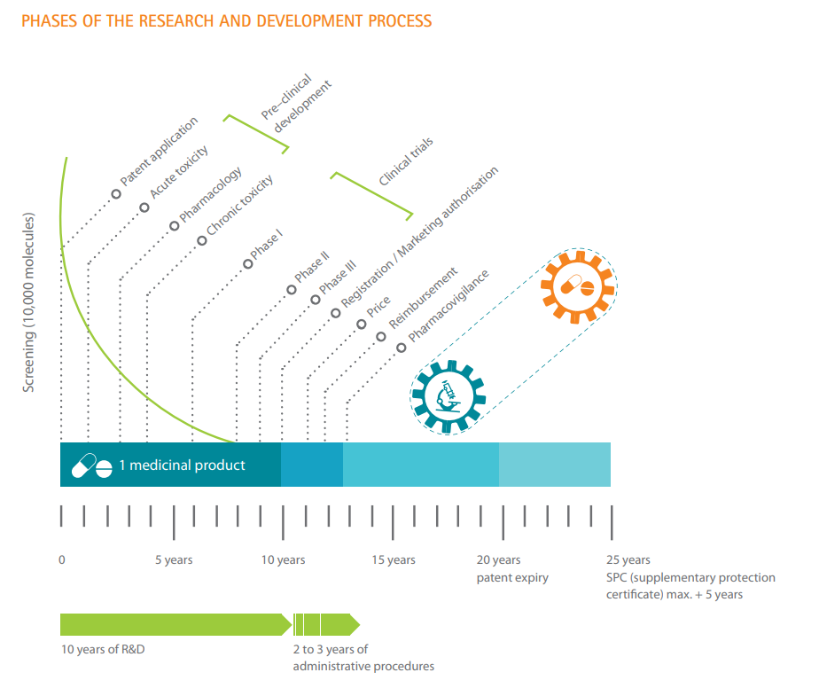
Drug/Device Product Development and Regulation - Europe and US Introduction

Slide 42
Drug/Device Product Development and Regulation - Europe and US Introduction

Slide 43
Drug/Device Product Development and Regulation - Europe and US Introduction
Definitions

Slide 44
Drug/Device Product Development and Regulation - Europe and US Definitions
More specifically, Article 1(2) of Directive 2001/83/EC3 establishes the following definition of medicinal product:
(a) Any substance or combination of substances presented as having properties for treating or preventing disease in human beings; or
(b) Any substance or combination of substances which may be used in or administered to human beings either with a view to restoring, correcting or modifying physiological functions by exerting a pharmacological, immunological or metabolic action, or to making a medical diagnosis.
Drugs are defined as articles intended for use in the diagnosis, cure, mitigation, treatment, or prevention of disease and as articles intended to affect the structure or any function of the body of man or animals. (FDA)

Slide 45
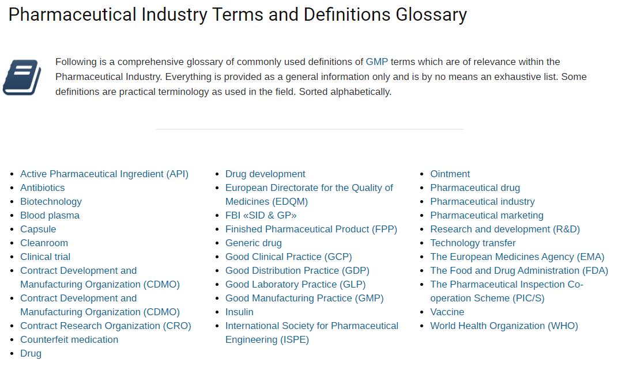
Drug/Device Product Development and Regulation - Europe and US Definitions

Slide 46
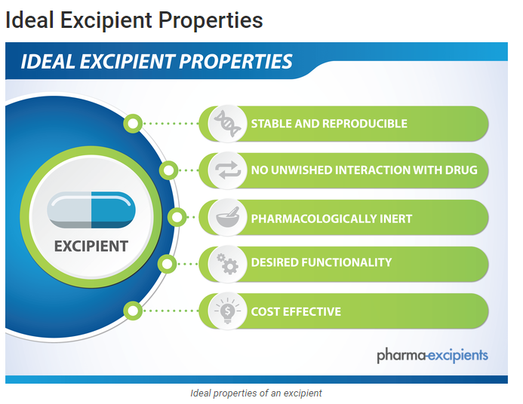
Drug/Device Product Development and Regulation - Europe and US Definitions

Slide 47
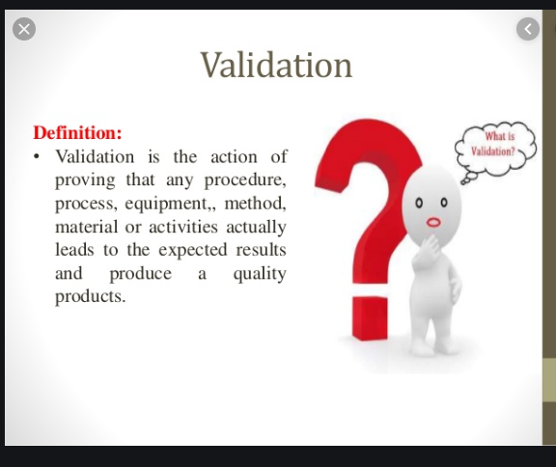
Drug/Device Product Development and Regulation - Europe and US Definitions

Slide 48
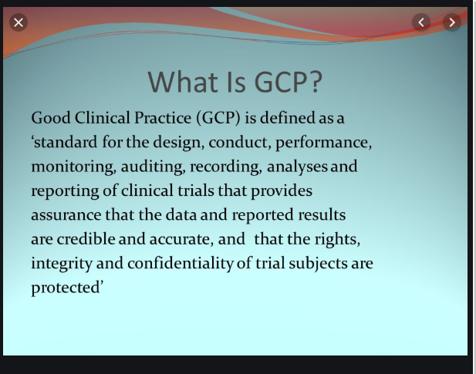
Drug/Device Product Development and Regulation - Europe and US Definitions

Slide 49
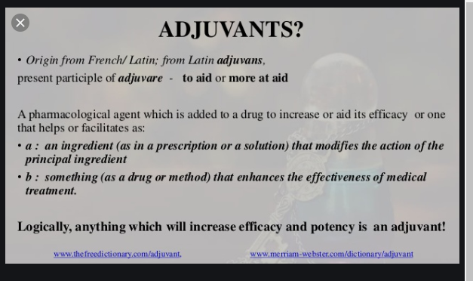
Drug/Device Product Development and Regulation - Europe and US Definitions

Slide 50
Drug/Device Product Development and Regulation - Europe and US Definitions
Half-Life and ADME
The drug half-life (t_{1/2}) is the time required for a drug concentration to decrease by 50%. Half-life is a first-order kinetic process because the same proportion, 50%, of the drug is removed during equal periods.
ADME is an abbreviation in pharmacokinetics and pharmacology for "absorption, distribution, metabolism, and excretion", and describes the disposition of a pharmaceutical compound within an organism

Slide 51
Drug/Device Product Development and Regulation - Europe and US Definitions
Comprehensive list:
https://www.ivowen.com/regulatory-affairs-common-abbreviations-acronyms/

Slide 52
Drug/Device Product Development and Regulation - Europe and US
Preclinical overview

Slide 53
Drug/Device Product Development and Regulation - Europe and US
Key EMA Guidance for First-in-Humans:
https://www.ema.europa.eu/en/documents/scientific-guideline/guideline-strategies-identify-mitigate-risks-first-human-early-clinical-trials-investigational_en.pdf

Slide 54
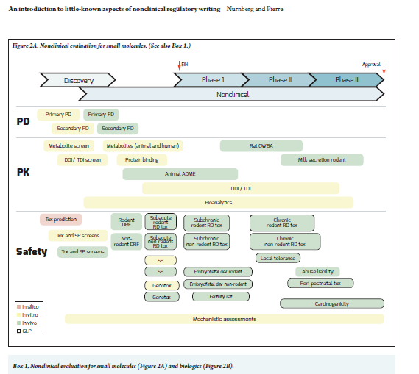
Drug/Device Product Development and Regulation - Europe and US Preclinical overview

Slide 55
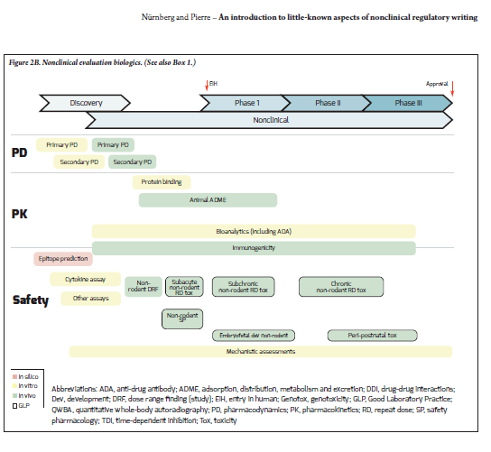
Drug/Device Product Development and Regulation - Europe and US Preclinical overview

Slide 56
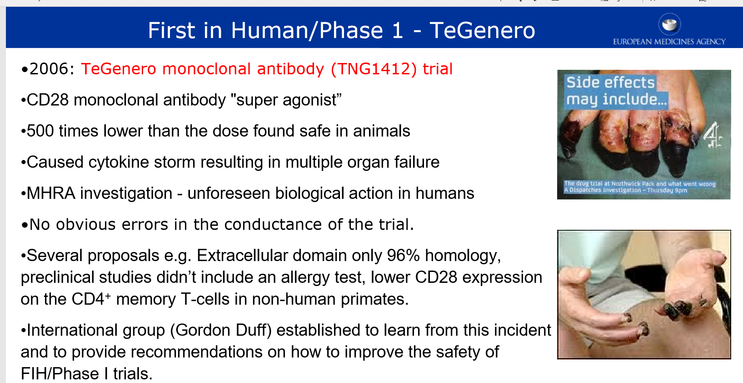
Drug/Device Product Development and Regulation - Europe and US Preclinical overview

Slide 57
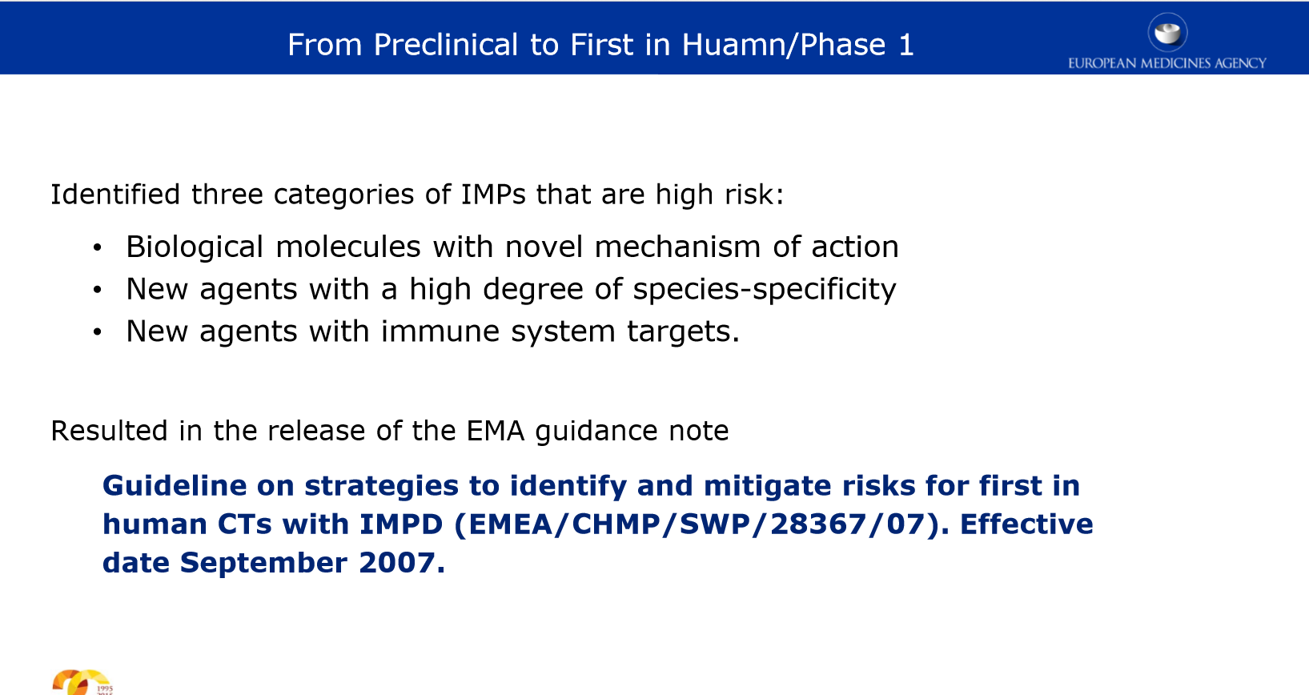
Drug/Device Product Development and Regulation - Europe and US Preclinical overview

Slide 58
Drug/Device Product Development and Regulation - Europe and US
Chemistry, Manufacturing and Controls (CMC)

Slide 59
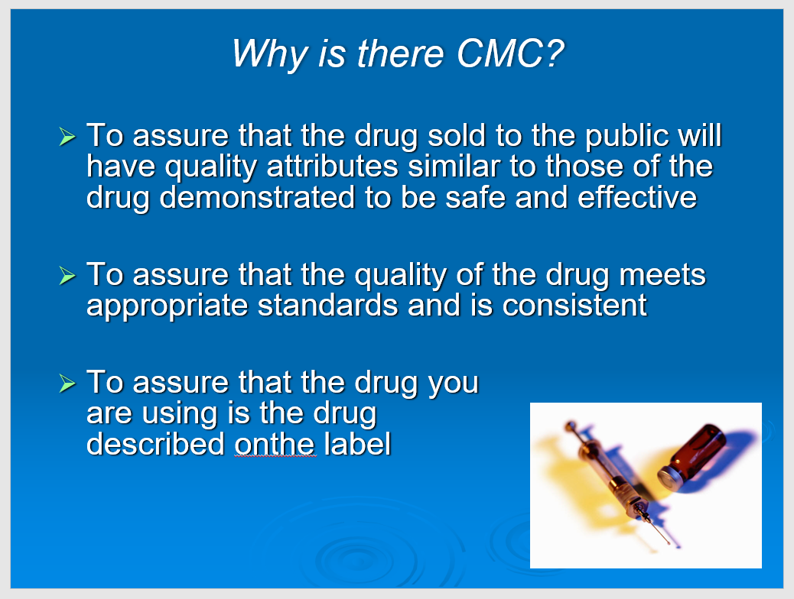
Drug/Device Product Development and Regulation - Europe and US CMC

Slide 60
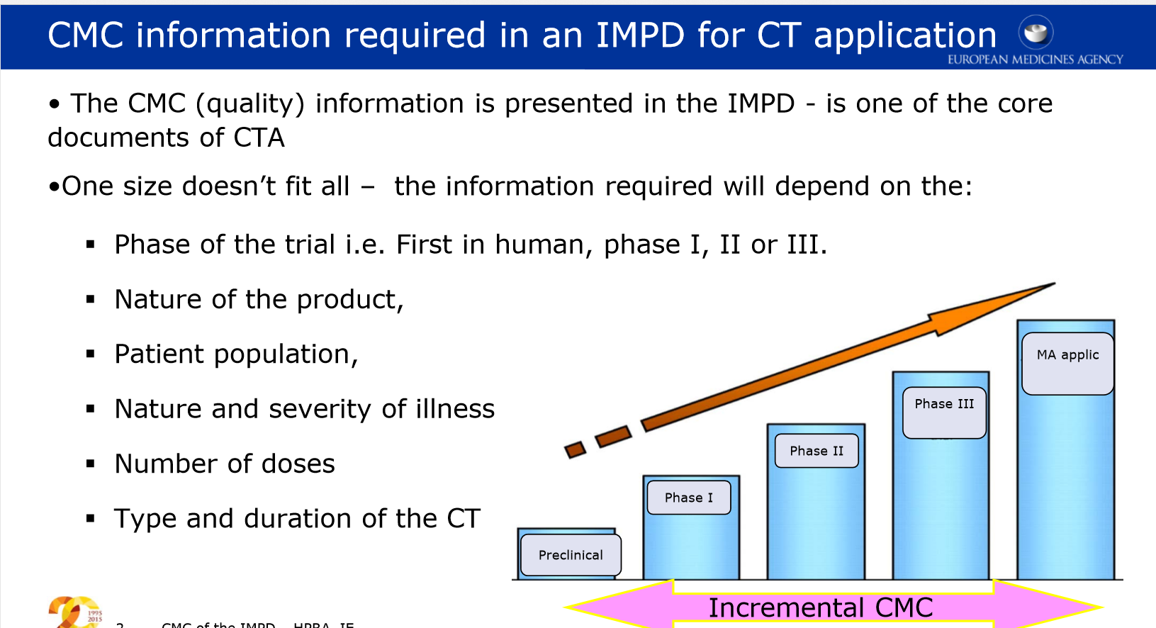
RA 761: Drug/Device Product Development and Regulation - Europe and US CMC

Slide 61
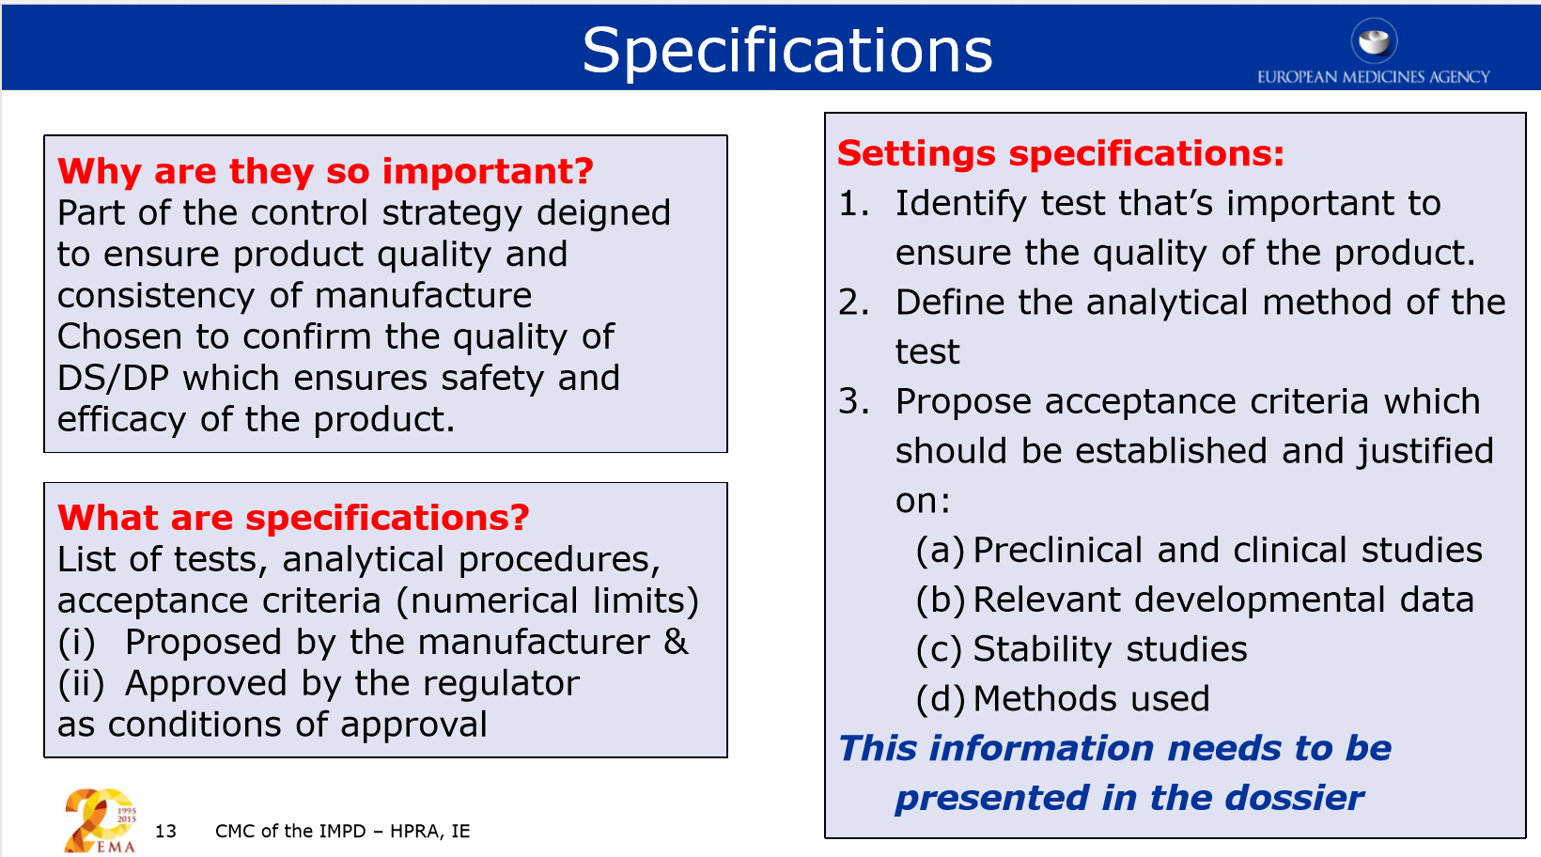
Drug/Device Product Development and Regulation - Europe and US CMC

Slide 62
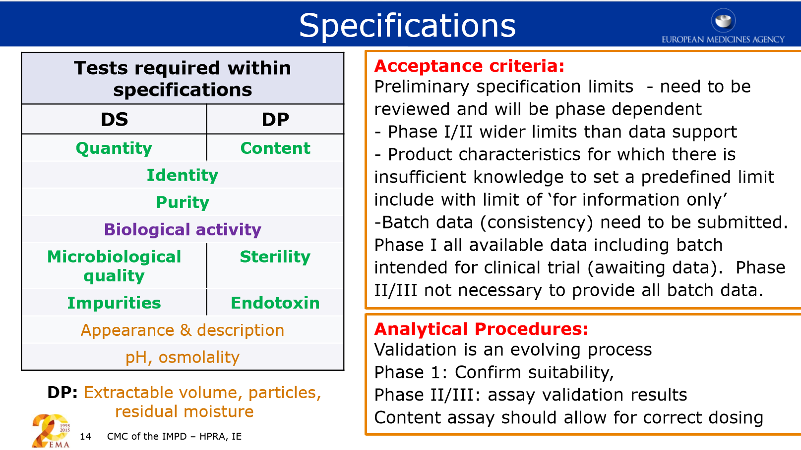
Drug/Device Product Development and Regulation - Europe and US CMC

Slide 63
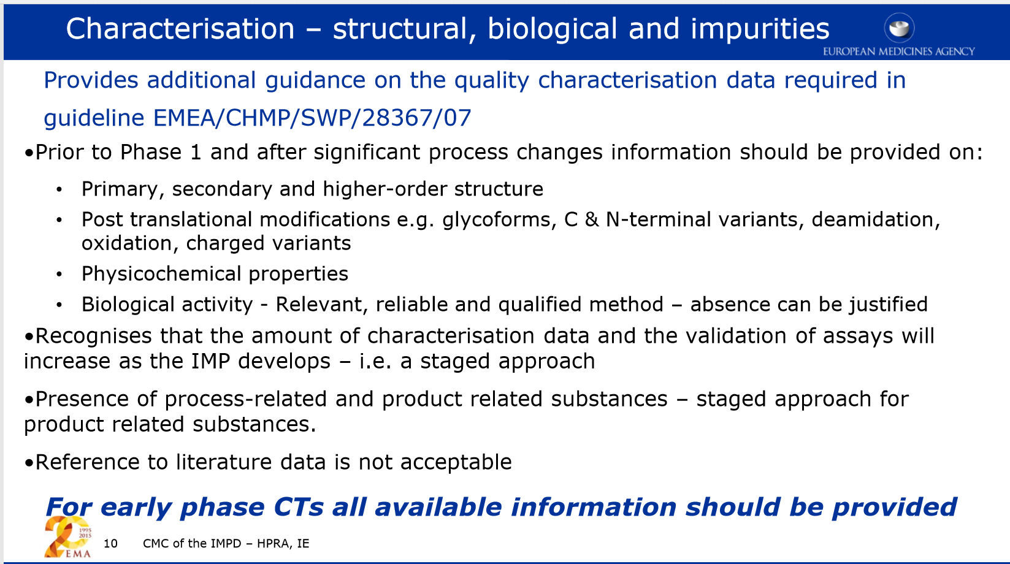
Drug/Device Product Development and Regulation - Europe and US CMC

Slide 64
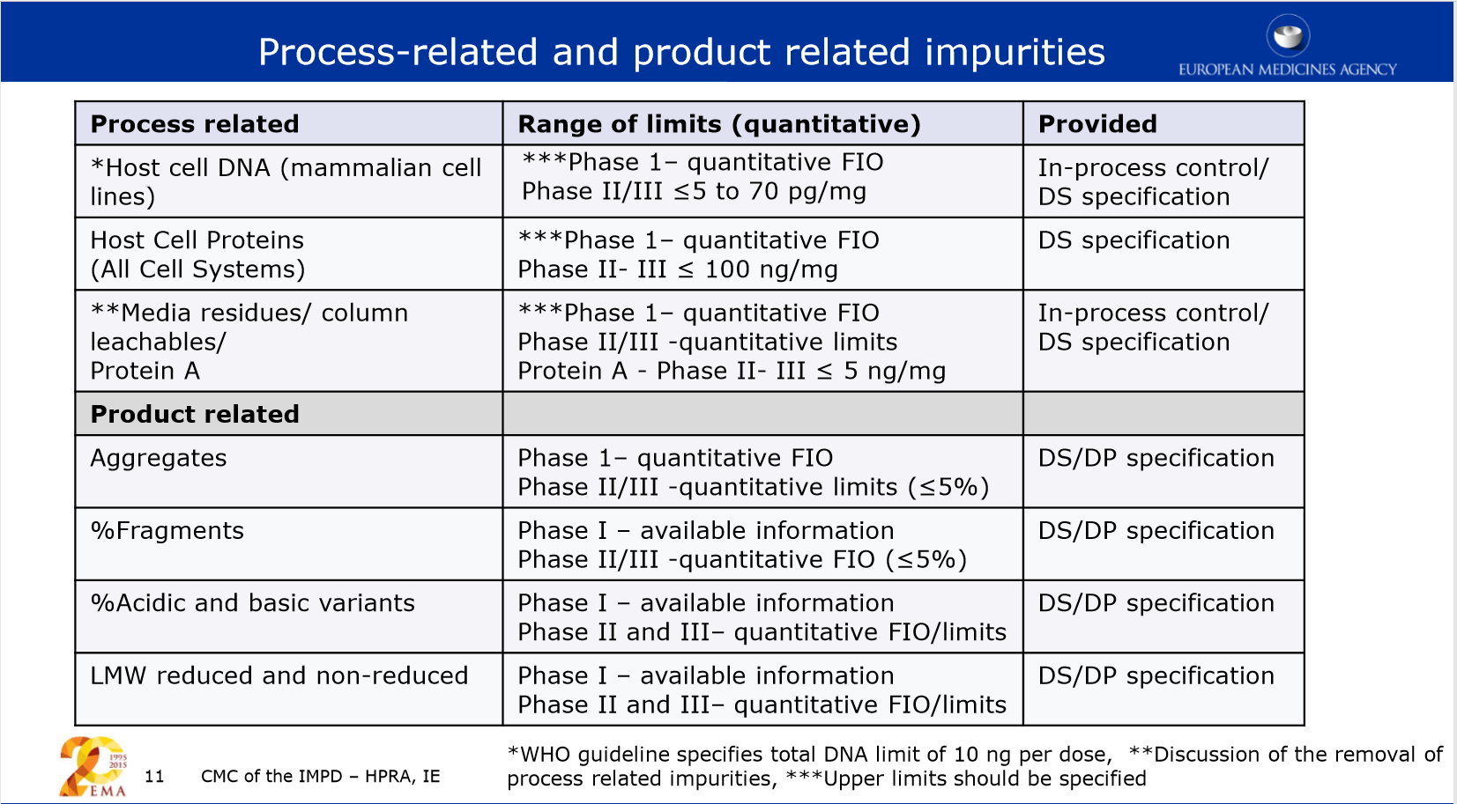
Drug/Device Product Development and Regulation - Europe and US CMC

Slide 65
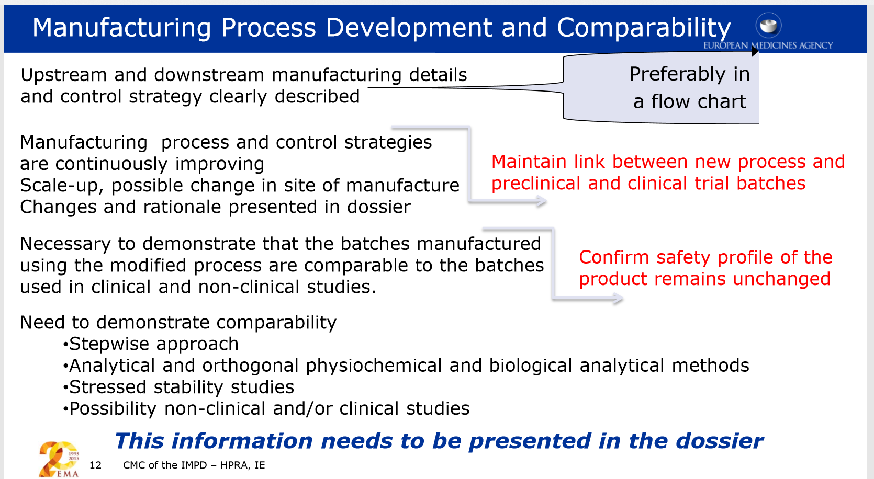
Drug/Device Product Development and Regulation - Europe and US CMC

Slide 66
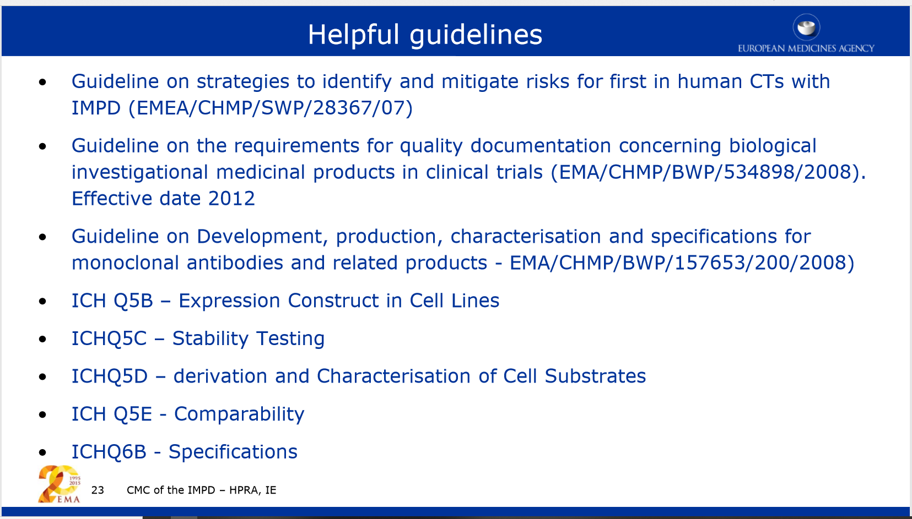
Drug/Device Product Development and Regulation - Europe and US CMC – Guidance, check for updates before use!!

Slide 67
RA 761: Drug/Device Product Development and Regulation - Europe and US Clinical Overview
CLINICAL OVERVIEW

Slide 68
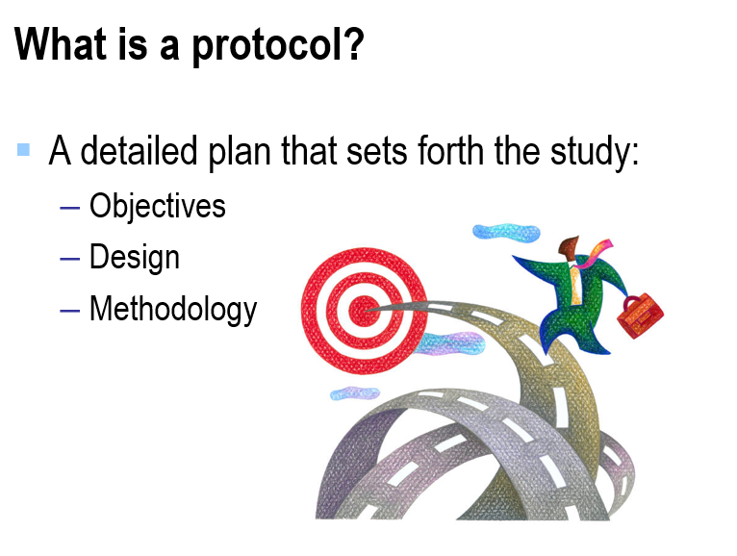
Drug/Device Product Development and Regulation - Europe and US Clinical Overview - The Clinical Trial Protocol

Slide 69
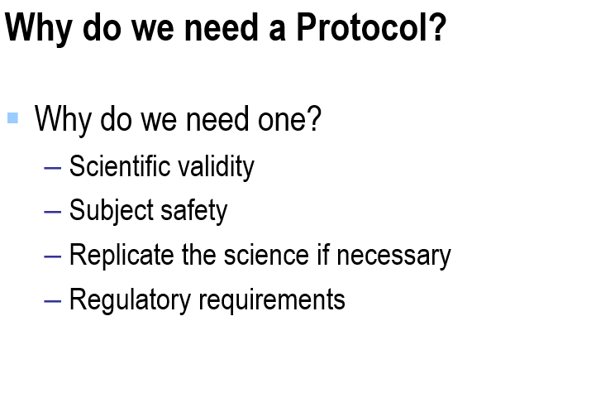
Drug/Device Product Development and Regulation - Europe and US Clinical Overview

Slide 70
Drug/Device Product Development and Regulation - Europe and US Clinical Overview
Who Writes the Protocol:
Sponsor
Commercial manufacturer
Pharmaceutical or Biotech company
Medical Device company
Investigators and study team
Investigator initiated

Slide 71
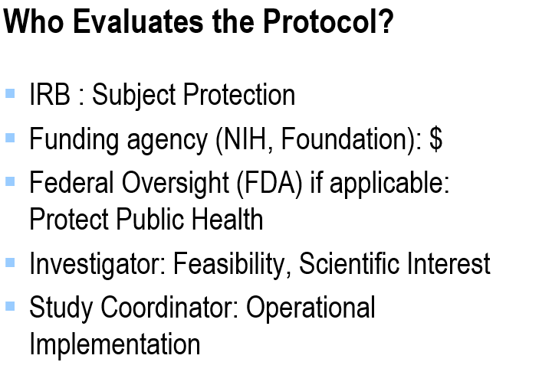
Drug/Device Product Development and Regulation - Europe and US Clinical Overview

Slide 72
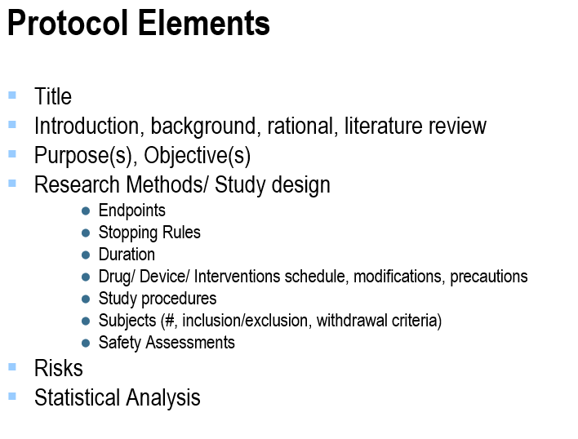
Drug/Device Product Development and Regulation - Europe and US Clinical Overview

Slide 73
Drug/Device Product Development and Regulation - Europe and US Clinical Overview
ICHGuidance:
https://database.ich.org/sites/default/files/E6_R2_Addendum.pdf

Slide 74
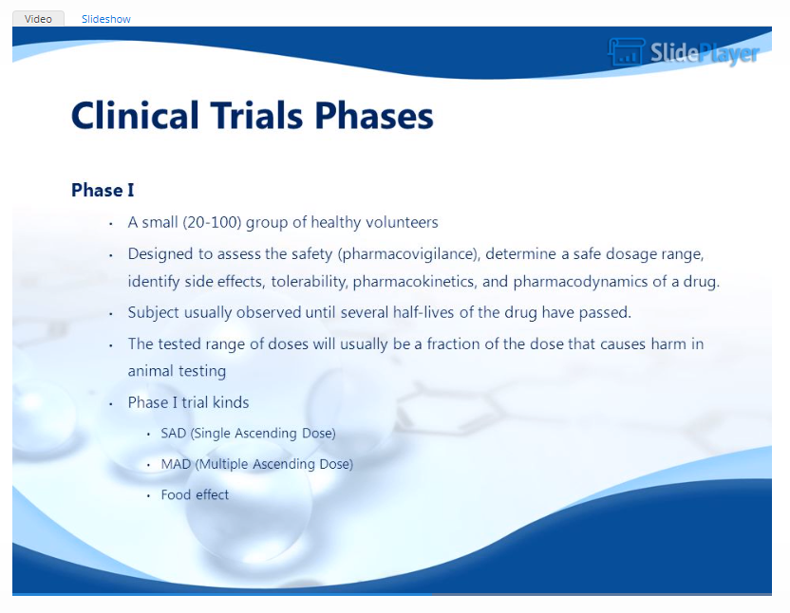
Drug/Device Product Development and Regulation - Europe and US Clinical Overview

Slide 75
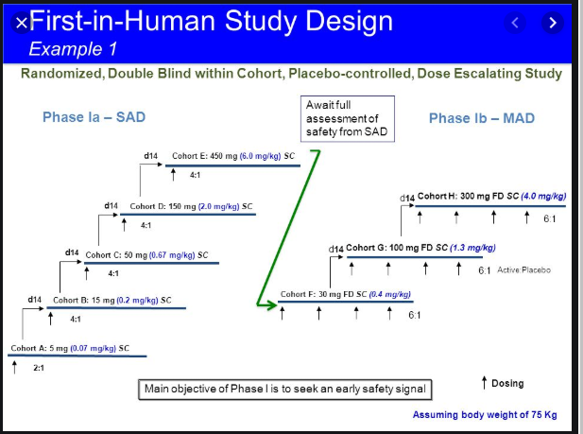
Drug/Device Product Development and Regulation - Europe and US Clinical Overview

Slide 76
Drug/Device Product Development and Regulation - Europe and US Clinical Overview
….FIH studies require cross‐functional collaboration to be successful. Adaptive study design allows many questions to be answered, which will benefit downstream clinical development. The monitoring and collection of safety data in FIH studies is similar to the conduct of later‐stage studies, requiring explicit plans to monitor and evaluate the safety data.
https://www.ncbi.nlm.nih.gov/pmc/articles/PMC6342261/
…..We anticipate that the MABEL-based approach will be more frequently used in FIH studies with mAbs in the future, while the NOAEL-based approach is still likely to be the most commonly used method.
file:///C:/Users/Gautam/Dropbox/GM_Folders/5_Network/12_RA_696_EPFL_SDSU_2020/03_LITT/Determination%20of%20the%20starting%20dose%20in%20the%20first-in-human%20clinical%20trials%20with%20monoclonal%20antibodies_%20a%20systematic%20review%20of%20papers%20published%20between%201990%20and%202013.html

Slide 77
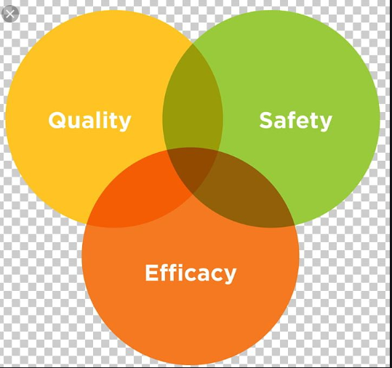
Drug/Device Product Development and Regulation - Europe and US Regulations - Europe

Slide 78
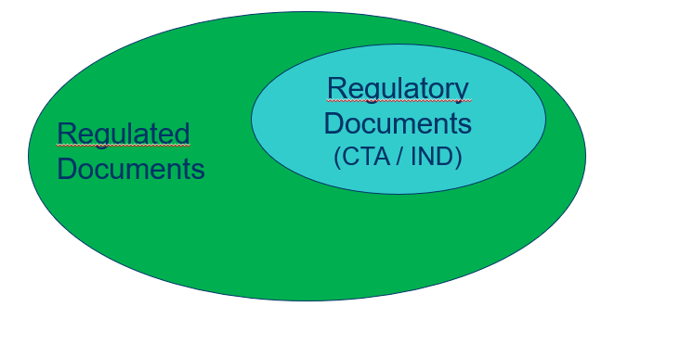
Drug/Device Product Development and Regulation - Europe and US Regulations - Europe

Slide 79
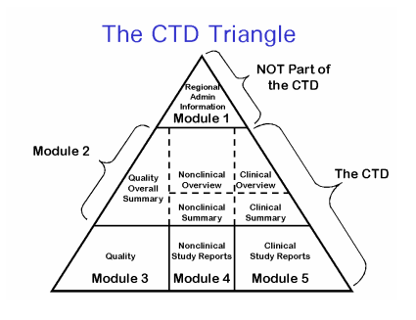
Drug/Device Product Development and Regulation - Europe and US Regulations - Europe – The Application Style

Slide 80
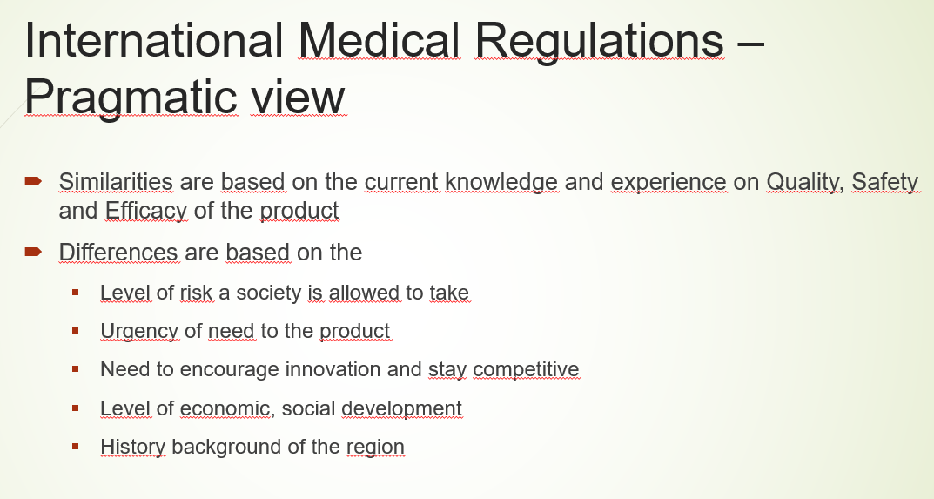
Drug/Device Product Development and Regulation - Europe and US Regulations - The cultural Factor

Slide 81
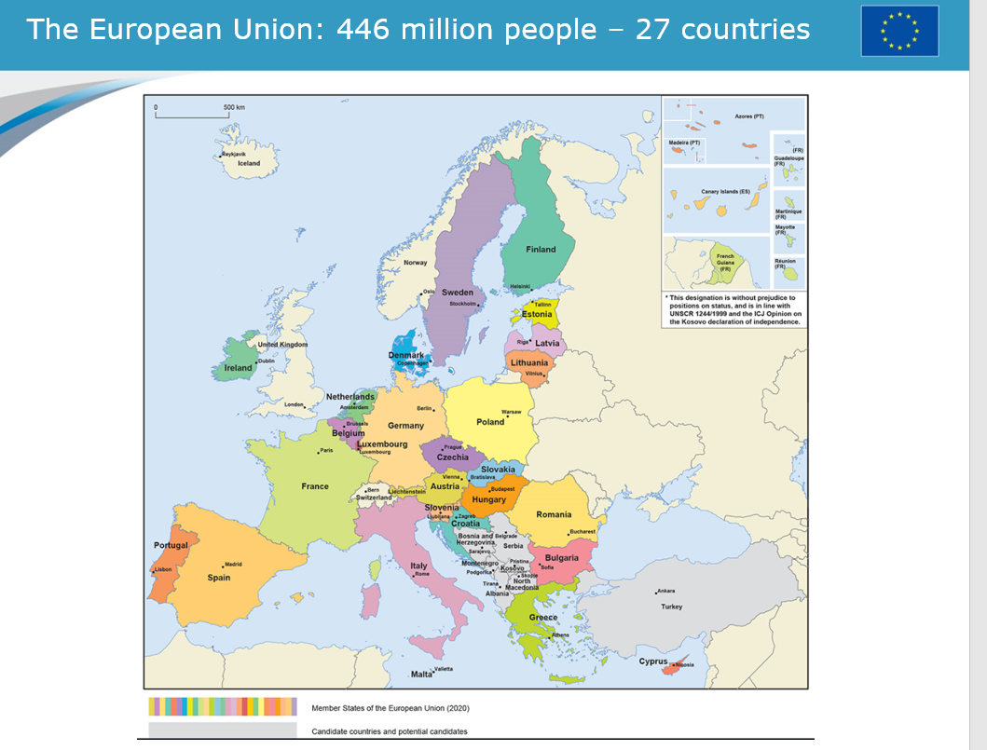
Drug/Device Product Development and Regulation - Europe and US Regulations - Europe, The EMA https://europa.eu/european-union/documents-publications/slide-presentations_en

Slide 82
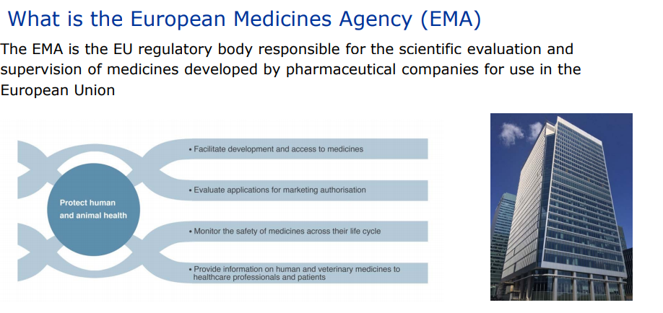
Drug/Device Product Development and Regulation - Europe and US Regulations - Europe, The EMA

Slide 83
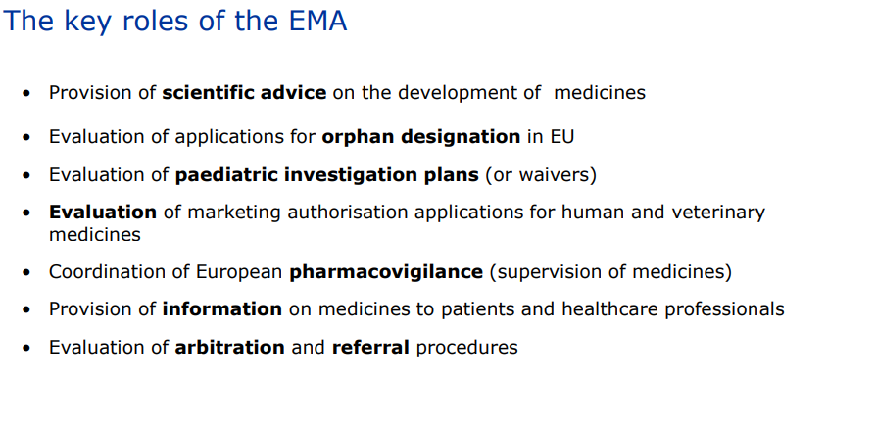
Drug/Device Product Development and Regulation - Europe and US

Slide 84
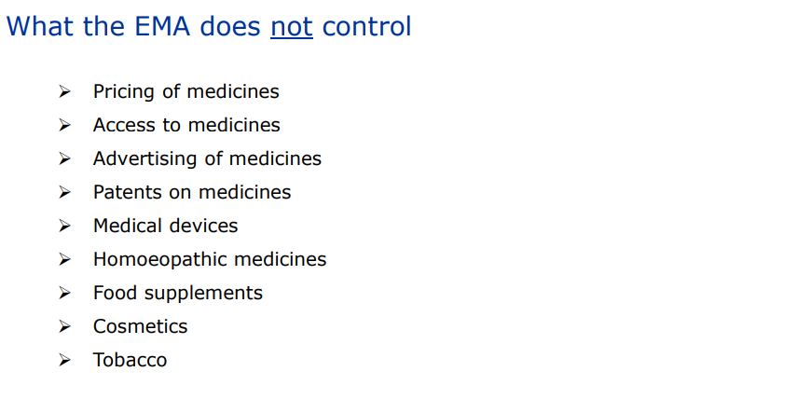
Drug/Device Product Development and Regulation - Europe and US

Slide 85
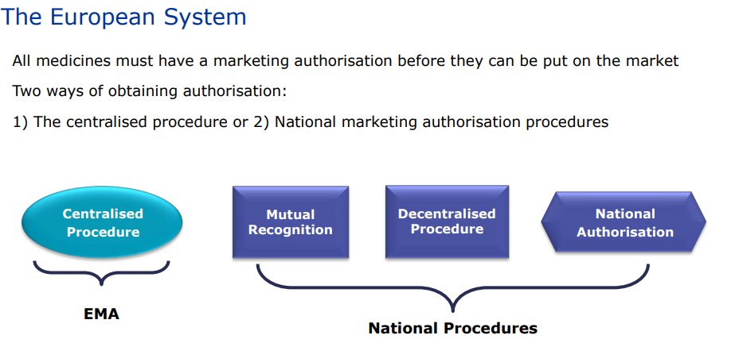
Drug/Device Product Development and Regulation - Europe and US

Slide 86
Drug/Device Product Development and Regulation - Europe and US
EMA further reading:
https://www.ema.europa.eu/en/documents/presentation/presentation-european-medicines-agency-ema-nathalie-bere-maria-mavris_en.pdf

Slide 87
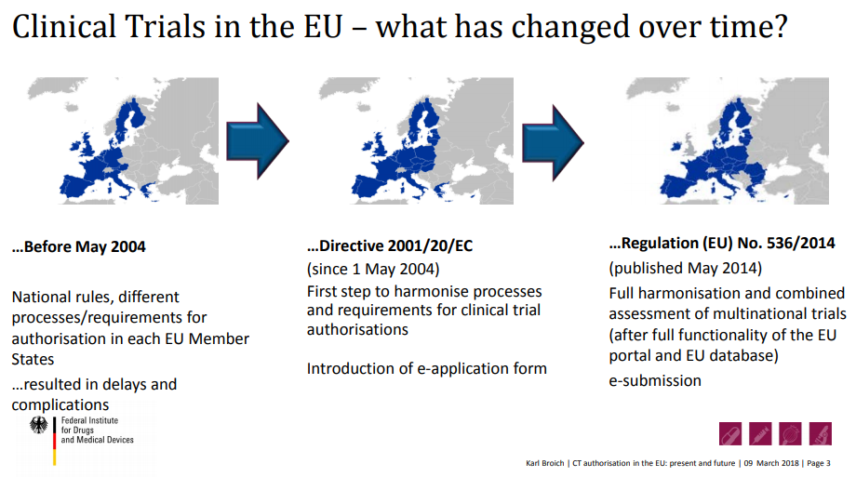
Drug/Device Product Development and Regulation - Europe and US EU Clinical Trial Applications

Slide 88
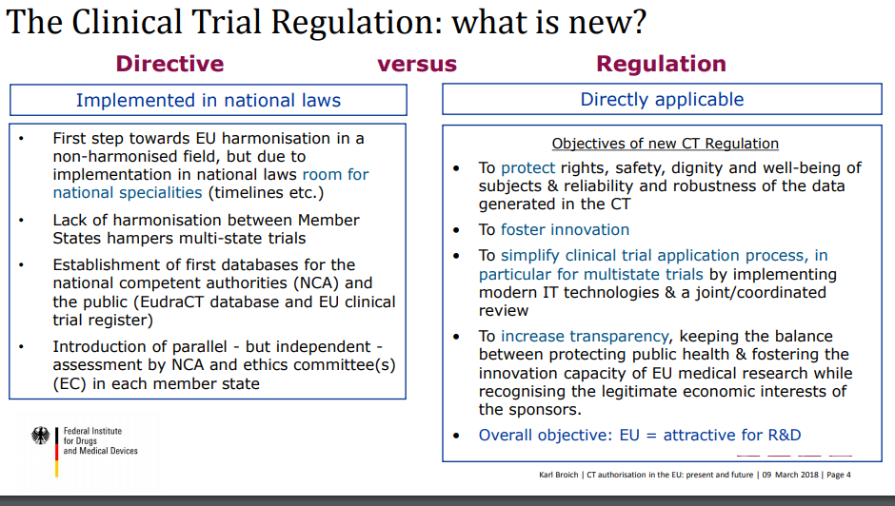
Drug/Device Product Development and Regulation - Europe and US EU Clinical Trial Applications

Slide 89
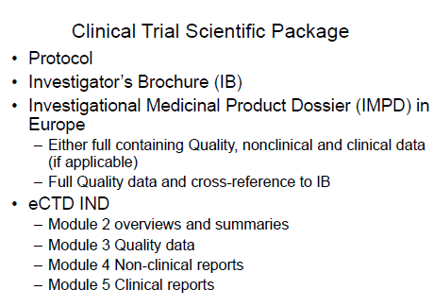
Drug/Device Product Development and Regulation - Europe and US EU Clinical Trial Applications

Slide 90
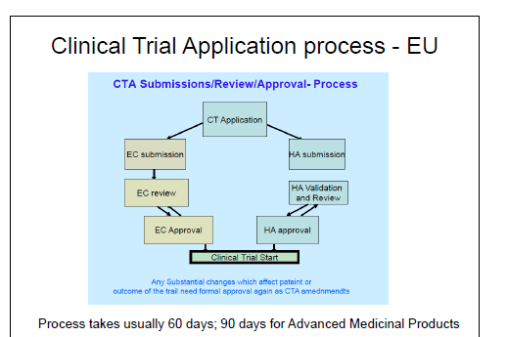
Drug/Device Product Development and Regulation - Europe and US EU Clinical Trial Applications

Slide 91
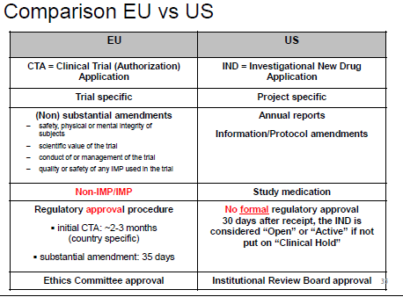
Drug/Device Product Development and Regulation - Europe and US EU Clinical Trial Applications

Slide 92
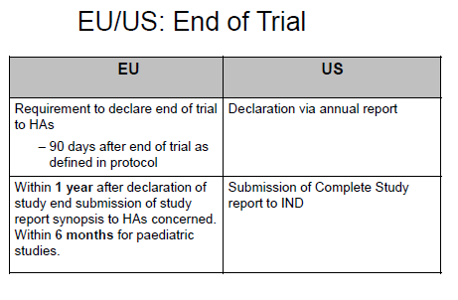
Drug/Device Product Development and Regulation - Europe and US EU Clinical Trial Applications

Slide 93
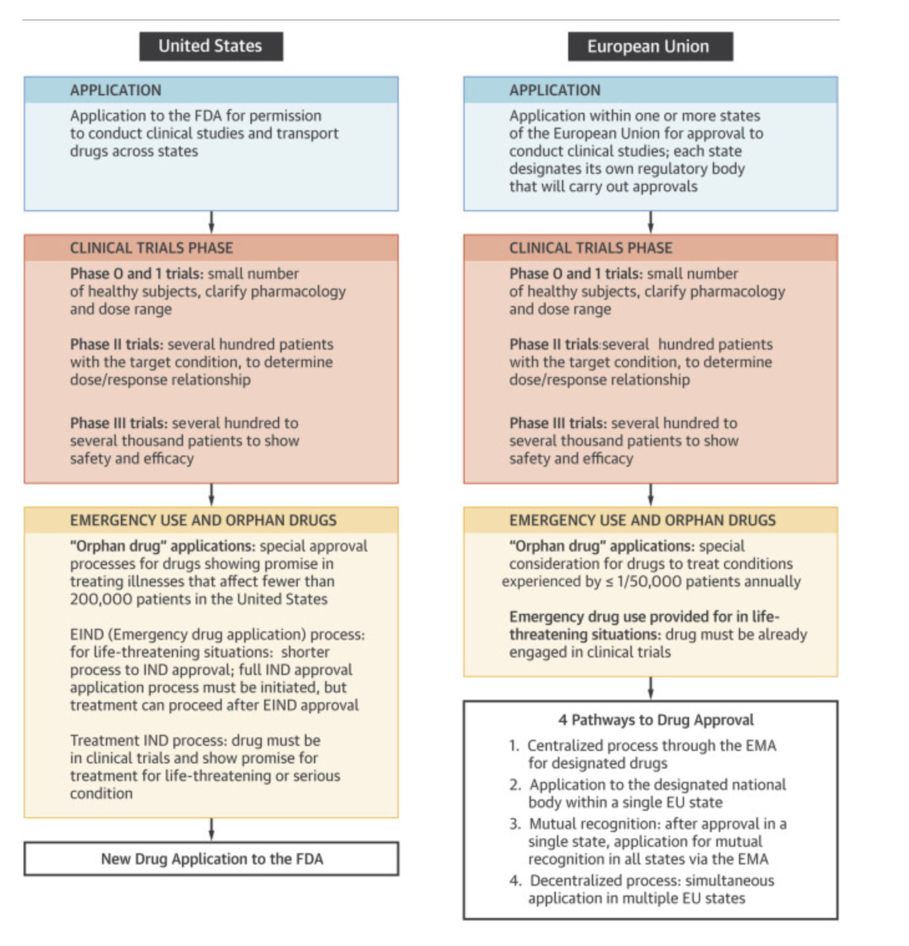
Drug/Device Product Development and Regulation - Europe and US EU AND US Clinical Trial Application: Comparison Drugs

Slide 94
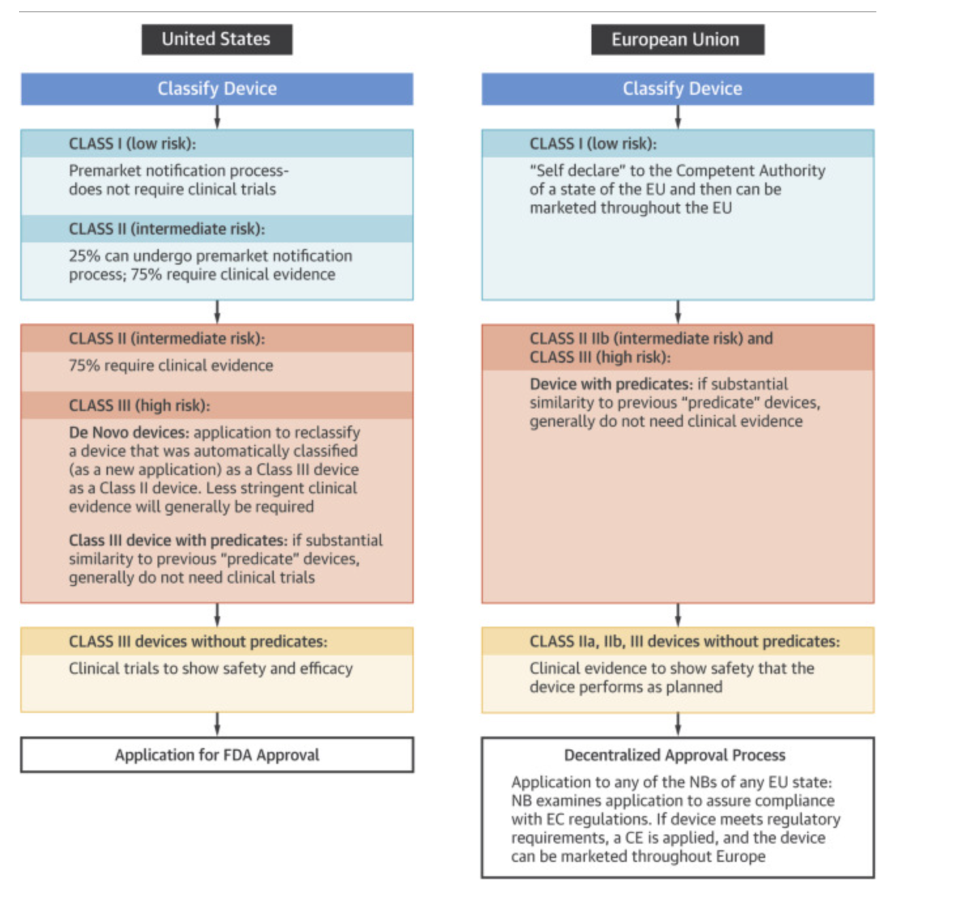
Drug/Device Product Development and Regulation - Europe and US EU AND US Clinical Trial Application: Comparison Medical Device

Slide 95
Drug/Device Product Development and Regulation - Europe and US EU Clinical Trial Applications
Further readings from Karl Broich, German Health Authority:
https://www.ema.europa.eu/en/documents/presentation/presentation-module-5-clinical-trials-european-union_en.pdf

Slide 96
Quote of the day
«Intelligence is not what you know, but what you do when you do not know»
- Jean Piaget

Slide 97
Drug/Device Product Development and Regulation - Europe and US
Thank you
- Gautam Maitra
Email: gautam.maitra@epfl.ch
Mob: +41 079 4395956

